Slide 1
Fitting the Smile

Slide 2
Introduction
Industry standard optimization algorithm: Levenberg-Marquardt
It is a local optimization algorithm
Advantage: Fast
Disadvantage: May get stuck in local minima

Slide 3
Introduction
We can choose initial parameters to mitigate the disadvantages and amplify the advantages.
Initial parameters close to the final solution will increase speed of the algorithm and reduce the risk of it finging a local minimum along the way.

Slide 4
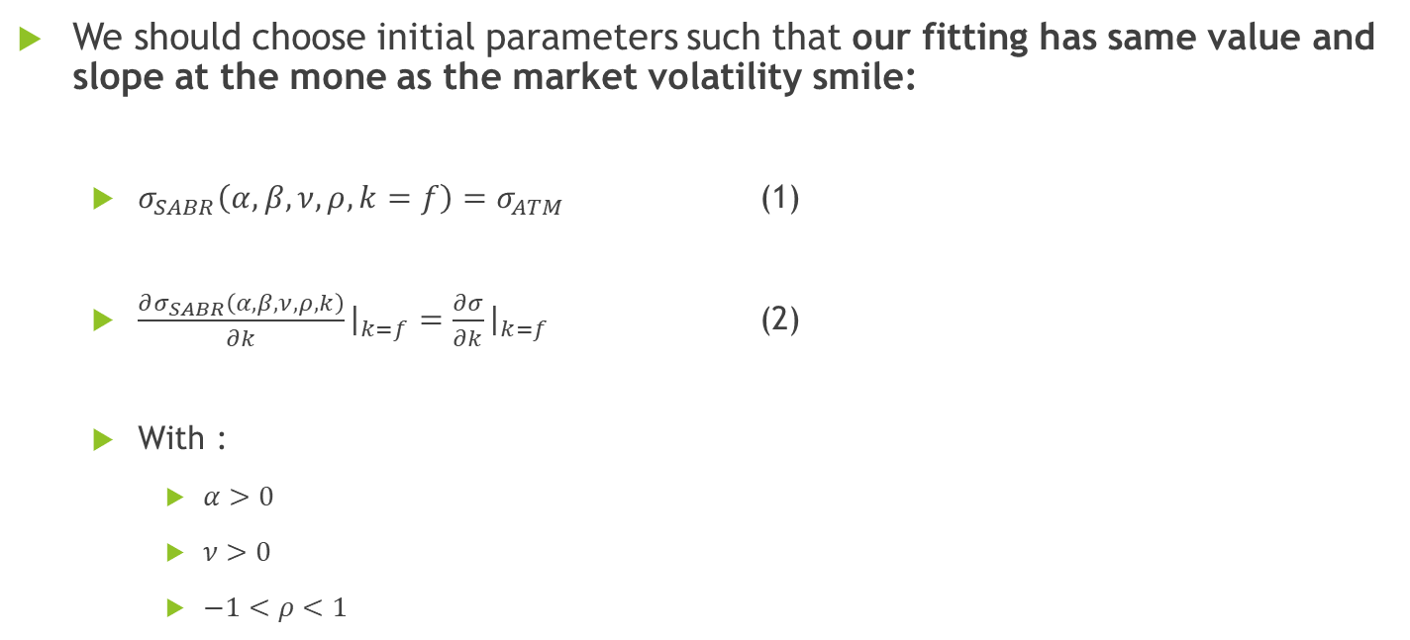
Before choosing initial parameters
We should choose initial parameters such that our fitting has same value and slope at the mone as the market volatility smile:
$σ_{SABR}\left(α, β,ν, ρ, k=f\right)=σ_{ATM}$ (1)
$\frac{∂σ_{SABR}\left(α, β,ν, ρ, k\right)}{∂k}{\left.​\right|}_{k=f}=\frac{∂σ}{∂k}{\left.​\right|}_{k=f}$ (2)
With :
$α>0$
$ν>0$
$−1<ρ<1$

Slide 5
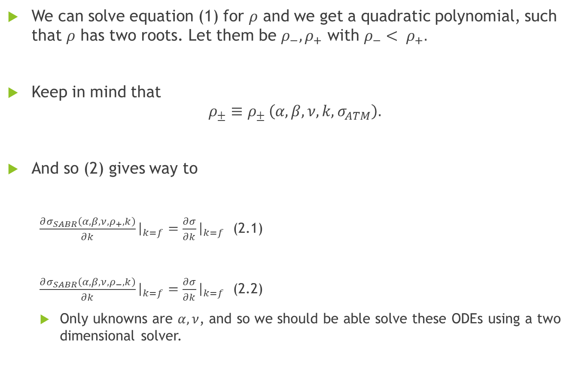
We can solve equation (1) for $ρ$ and we get a quadratic polynomial, such that $ρ$ has two roots. Let them be $ρ_{−}, ρ_{+}$ with $ρ_{−}< ρ_{+}.$
Keep in mind that
$$ρ_{±}≡ρ_{± }\left(α, β, ν, k, σ_{ATM}\right).$$
And so (2) gives way to
$\frac{∂σ_{SABR}\left(α, β,ν, ρ_{+}, k\right)}{∂k}{\left.​\right|}_{k=f}=\frac{∂σ}{∂k}{\left.​\right|}_{k=f}$ (2.1)
$\frac{∂σ_{SABR}\left(α, β,ν, ρ_{−}, k\right)}{∂k}{\left.​\right|}_{k=f}=\frac{∂σ}{∂k}{\left.​\right|}_{k=f}$ (2.2)
Only uknowns are $α, ν$, and so we should be able solve these ODEs using a two dimensional solver.

